Slide 1

PERT Method

Slide 2
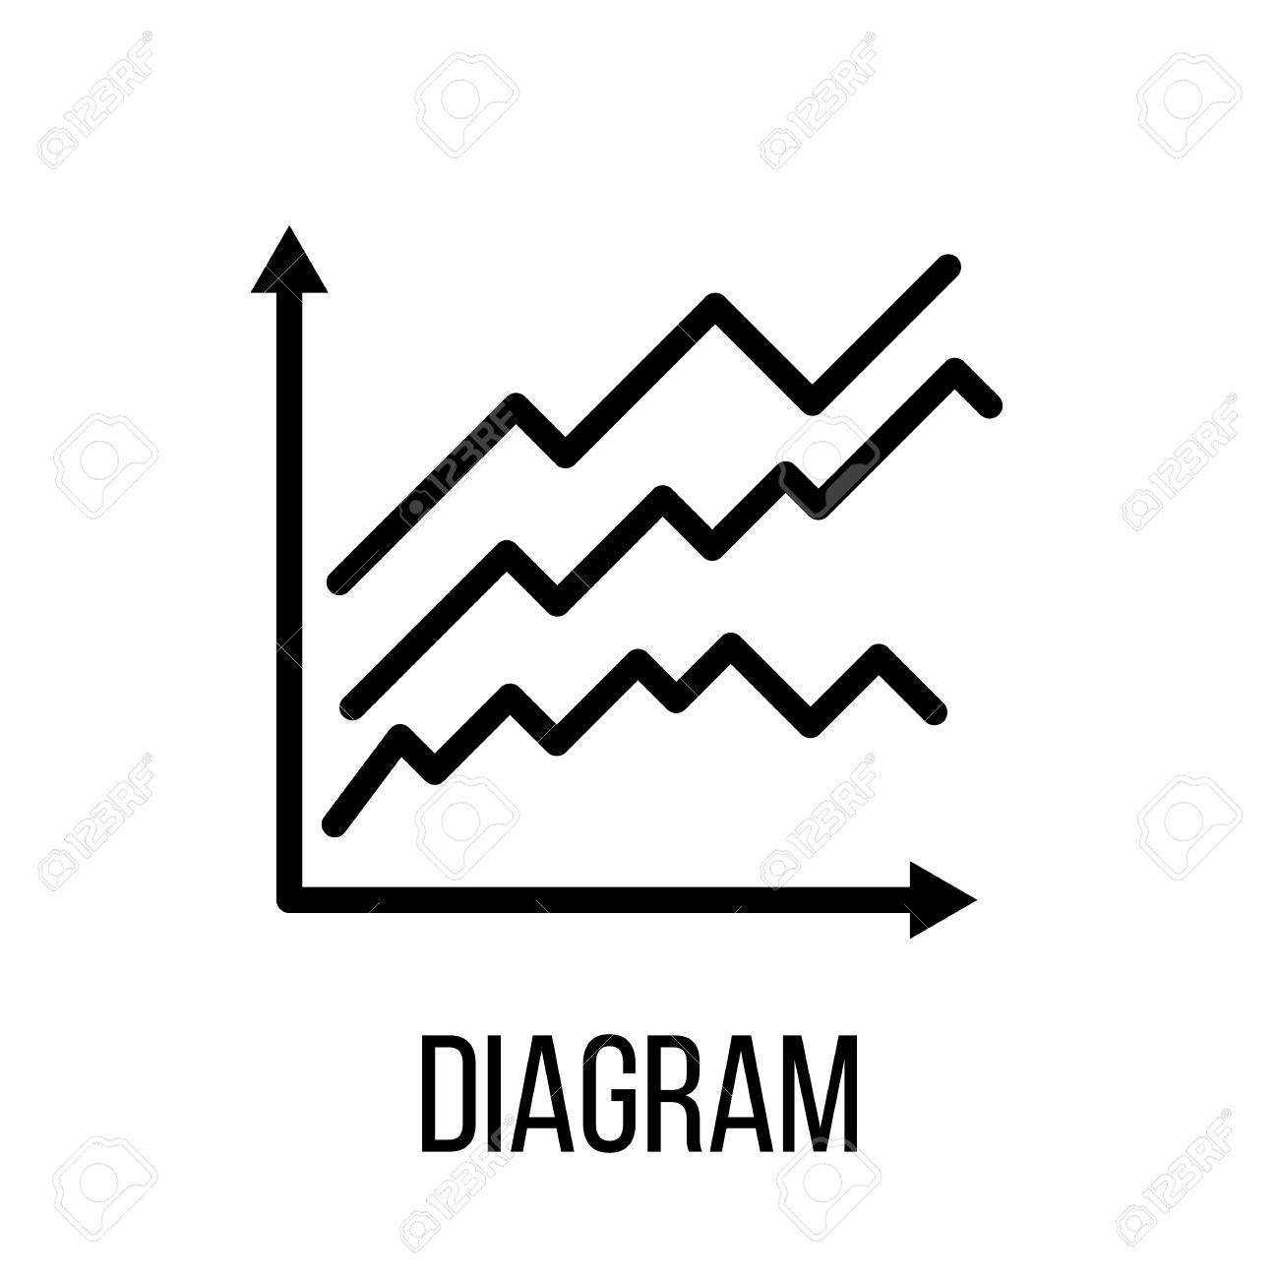
PERT Definition
Program Evaluation and Review Technique (PERT): is a project management tool used to schedule, organize, and coordinate tasks within a project. It is basically a method to analyse the tasks involded in completing a given projecy, especially the time needed to complete each task, and to identify the minimum time needed to complete the total project.
This method was developed in the USA in 1958 and has saved 2 years on the manufacture of Polaris rockets (project initially established over 7 years)

Slide 3

When we use PERT ?
PERT is used when activity times are uncertain :
- Determine the duration of the project
- Decision making under risk (P for probabilistic)

Slide 4
Determine the project
The PERT presents in a visual way the logical sequence of tasks in view
- to facilitate its coordination and control
- to improve the forecasts of duration and cost
The PERT is therefore a network of
Circle: called "steps"
Arrows called "tasks"

Slide 5
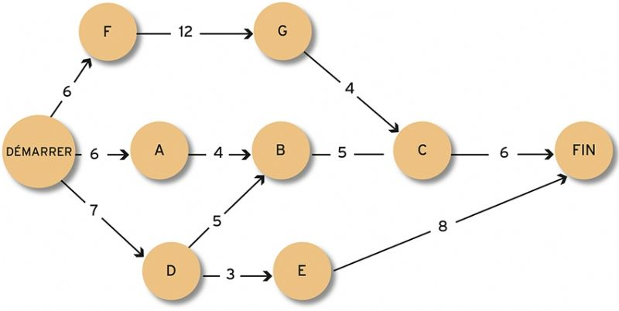
The PERT method, systematically used for construction projects, is commonly used in the company for problems.

