Slide 1
Emotional Intelligence
Noemi Jiménez, Zohair Takarromt

Slide 2
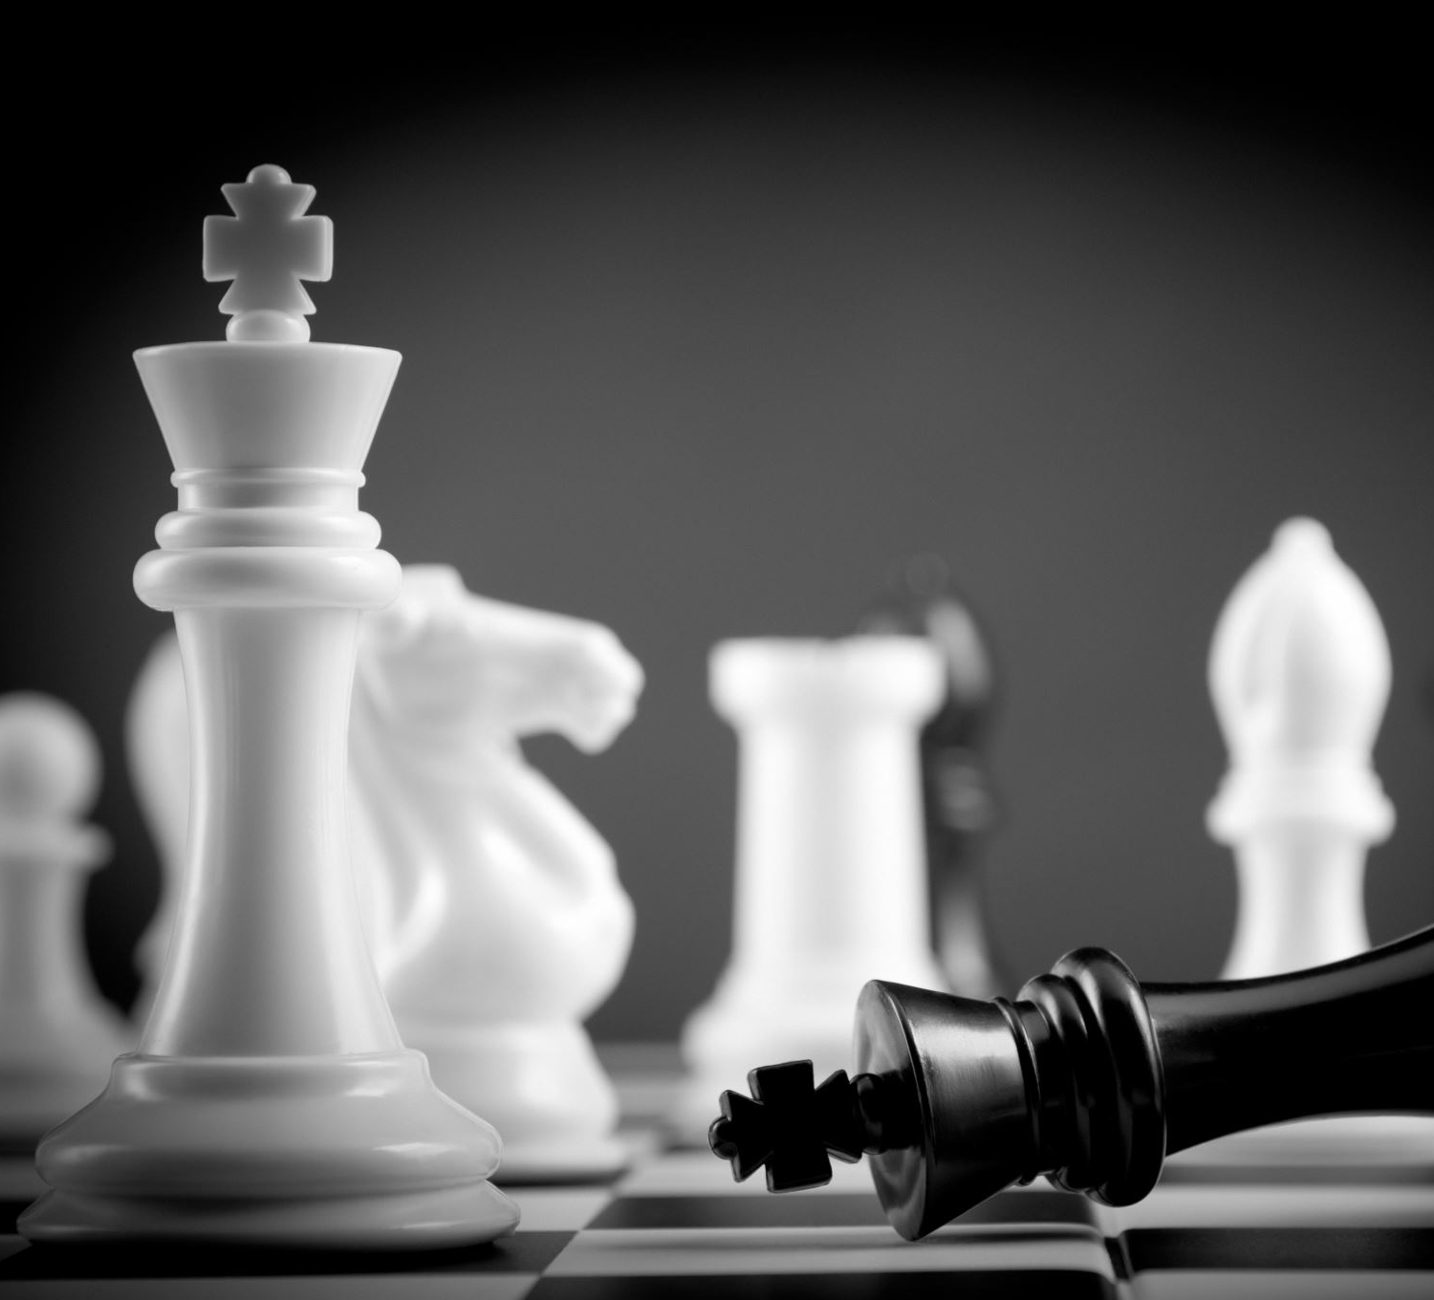
Multiple intelligences

Slide 3
Discussion :
What does intelligence mean for you ?

Slide 4
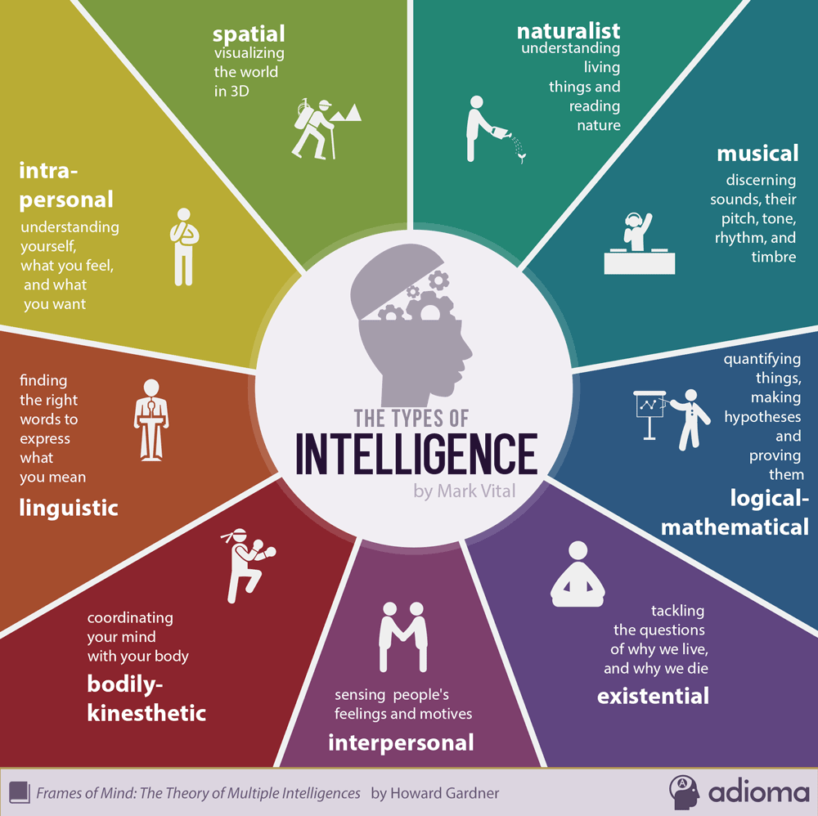
The different types of intelligence

Slide 5
Video : https://www.youtube.com/watch?v=s2EdujrM0vA

Slide 6
Discussion
How improve your skills ? Considering behavior and changes ?

Slide 7
Definition of the emotional intelligence
The ability to distinguish your own and other’s emotions
Concept coined in 1990 by psychologists Peter Salovey and John Mayer

Slide 8
Video : https://www.youtube.com/watch?v=n6MRsGwyMuQ

Slide 9
Discussion
Do you know this concept ? How do you use it?

Slide 10
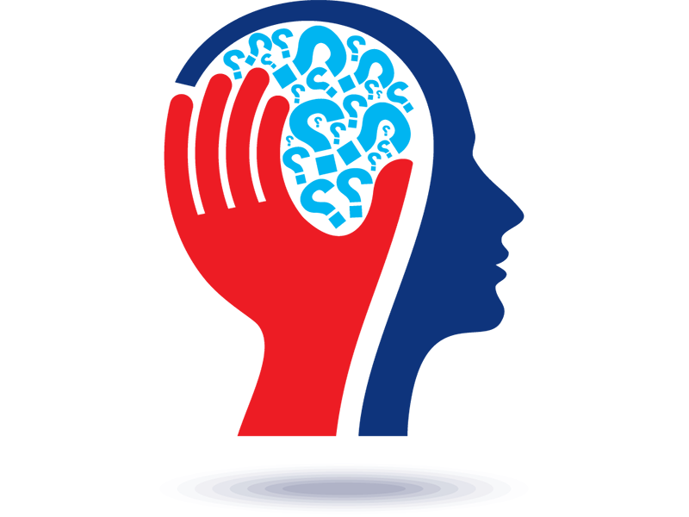
Elements of Emotional Intelligence
Personal competence :
  Self awarness
  Self-management
Social competence :
  Social awarness
  Relationship management

Slide 11
Video : https://www.youtube.com/watch?v=Y7m9eNoB3NU

Slide 12
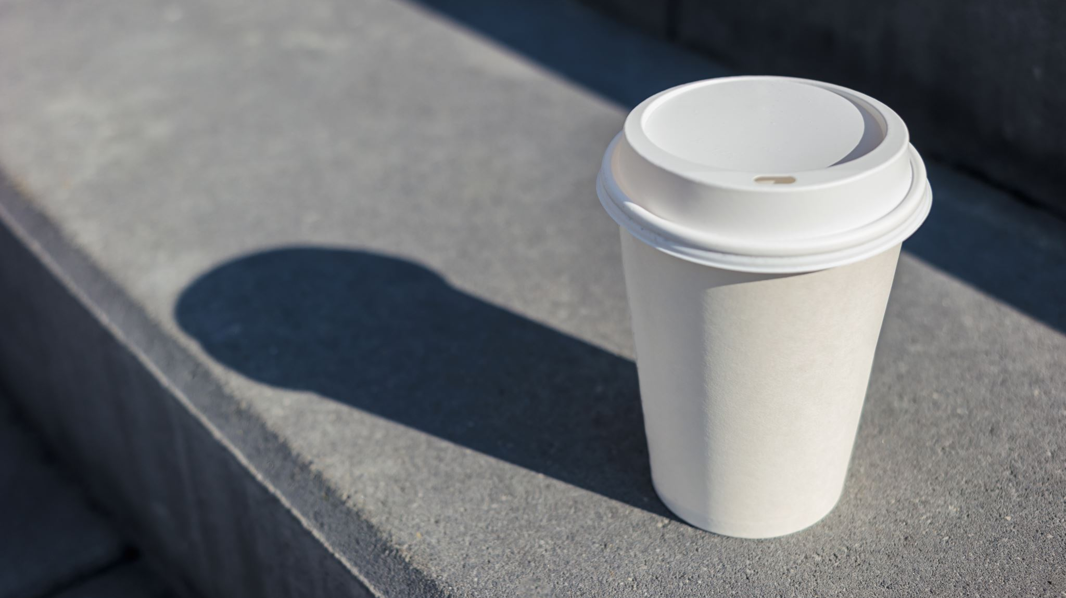
Break
15 minutes

Slide 13
KAHOOT TIME
Take your phones !

Slide 14
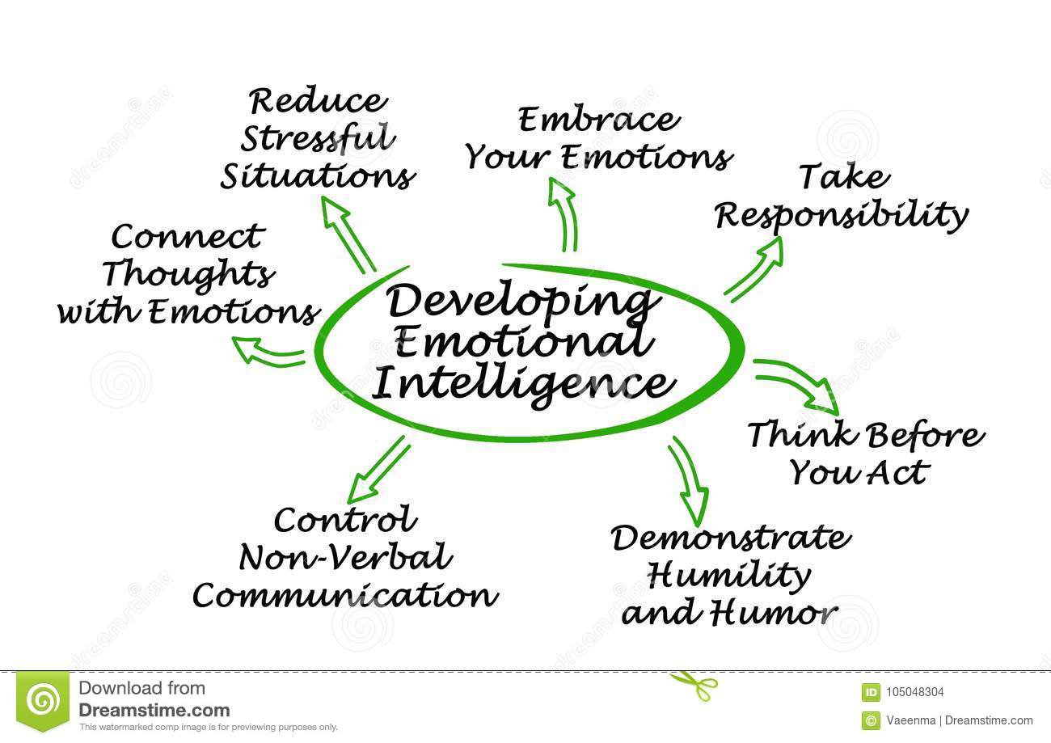
Emotional Intelligence skills

Slide 15
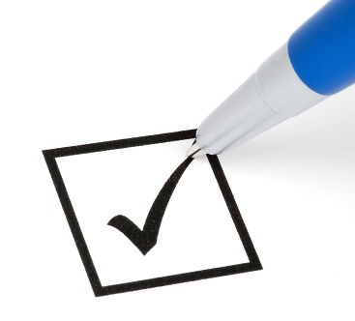
Group play
4 groups
Every group have one element of the Emotional Intelligence
Create a slideshow to present your elements of reflection
Identify 3 strategies you can use to improve your skill
Create one or several situation example (realistic or not ! Be creative)

Slide 16
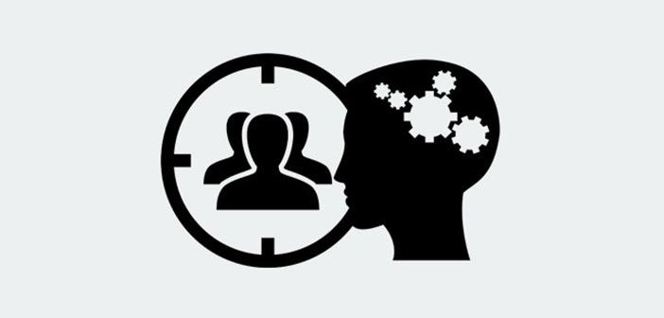
Essential skill in everyday life
At work
At home
In a leadership situation
In a relationship situation

Slide 17

Thank you for your attention

Slide 18
Motorola
Good: Good balance between discussion and theory Good vidéos Fresh subject Good preparation | Improve:
Learn: Many diff types of intelligences Kind of intelligences we can have | Action: Use self awareness in everyday life Think how we can affect others

