Slide 1
Unica Development
Survey results
(online & face-to-face)

Slide 2
Online questionnaire
Questions;
  1. Take-away (eco-friendly and/or re-usable with a deposit). Some positivity towards the idea, most answers were indifferent.
  2. Willing to pay more for special coffees/desserts/other. Strong positivity, some were not willing to pay more.
  4. Restaurant atmosphere. Strong disagreement. However, in question 6 many answered that the facilities are not inconvenient.
  7. Delica food is tasty. Some indifferent, most disagree.
  8. Unica conference room awareness. Most were not aware, some were not aware but interested in using them.

Slide 3
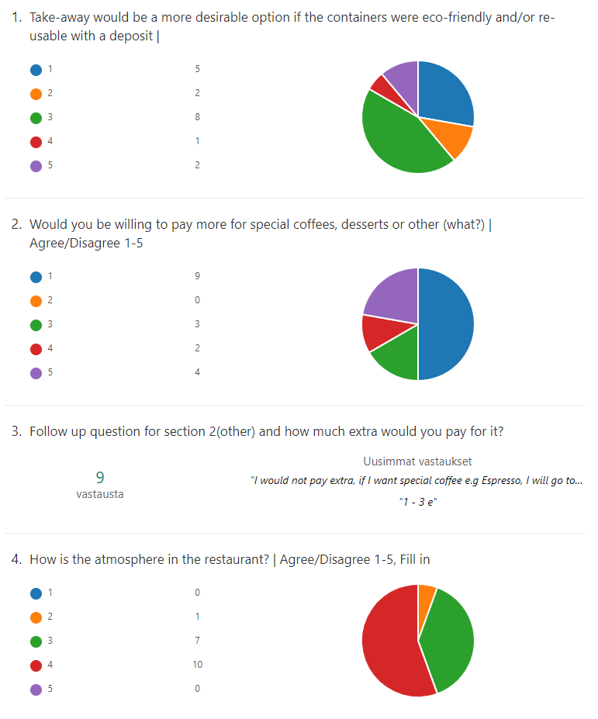
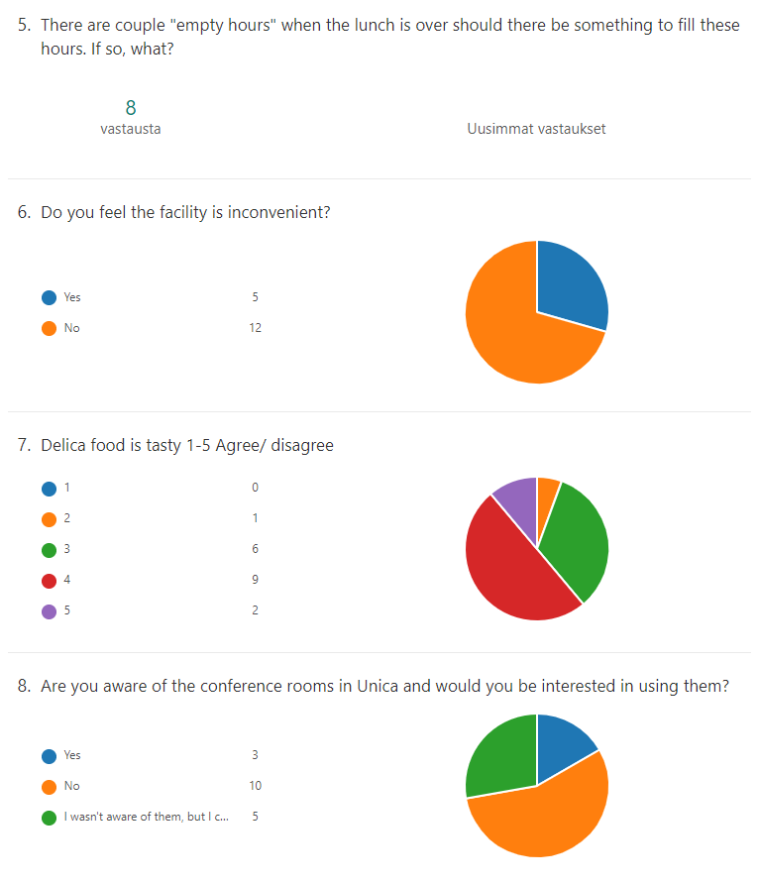

Slide 4
Face-to-face survey
Total of 42 people interviewed
Locations: Unica Delica, Deli Pharma, Unica Linus, Assarin Ullakko, Mauno & Sodexo Lemminkäinen

Slide 5
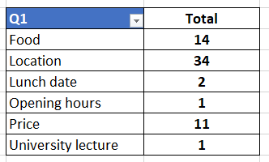
Q1. Why did you choose to come here today? Food/menu, price, facilities/premises, location?
Most lunch-goers choose their restaurant by location; current whereabouts, lectures/studies in the same building. Price and menú also have an effect on choice.

Slide 6
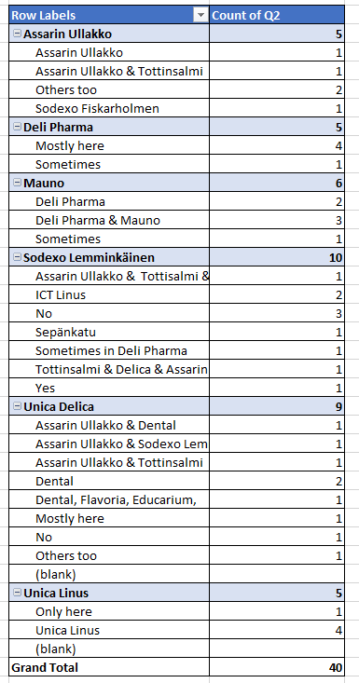
Q2. Do you always come here for lunch or are you also visiting other student restaurants? If so, which ones and what influences your decision?
Interesting points;
Unica Delica
People eat in many different locations, Delica being on of them
Decisions influenced by food & location mostly.
Deli Pharma
People who eat in Deli Pharma don’t seem to migrate as much, mostly always in the same place.

Slide 7
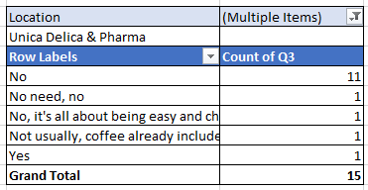
Q3. Would you be willing to pay more for special coffees, desserts or something else?
All disagree with paying more for desserts etc.
Coffee in Deli Pharma is already included

Slide 8
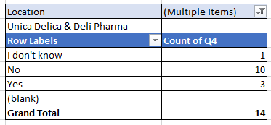
4. Would take-away be a more desirable option if the containers were eco-friendly and/or re-usable with a deposit?
Most thoughdon’t find take-away desirable
Some positivity in other restaurants

Slide 9
Q5. Do you know/visit Unica Delica? Why?
Most know and visit Unica Delica.
Half of the people tend to use restaurants near them, so people close to Unica visit more often.
Deciding factors are menú and location.
Included coffee in Deli Pharma attracts some towards Unica.

Slide 10
Q6. What’s good in Unica Delica and what could be improved?
+ Food, quality and taste, vegetarian options
+ Change lines of foods
+ Deli Pharma salad buffet
+ Lemon/orange waters are great
+ Premises/facilities
- Customer service is sometimes rude
- Layout of food lines could be changed to avoid crossing cues
- Open hours could be extended
- Dish returning could be improved
- Premises are a bit small

