Slide 1
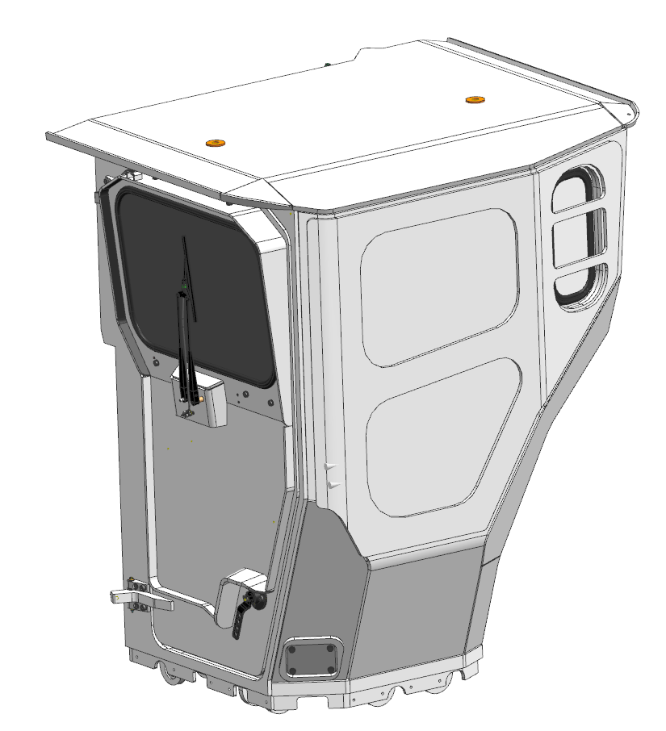
Backward
Front window
Forward
Corner window
Door
Door handle

Slide 2
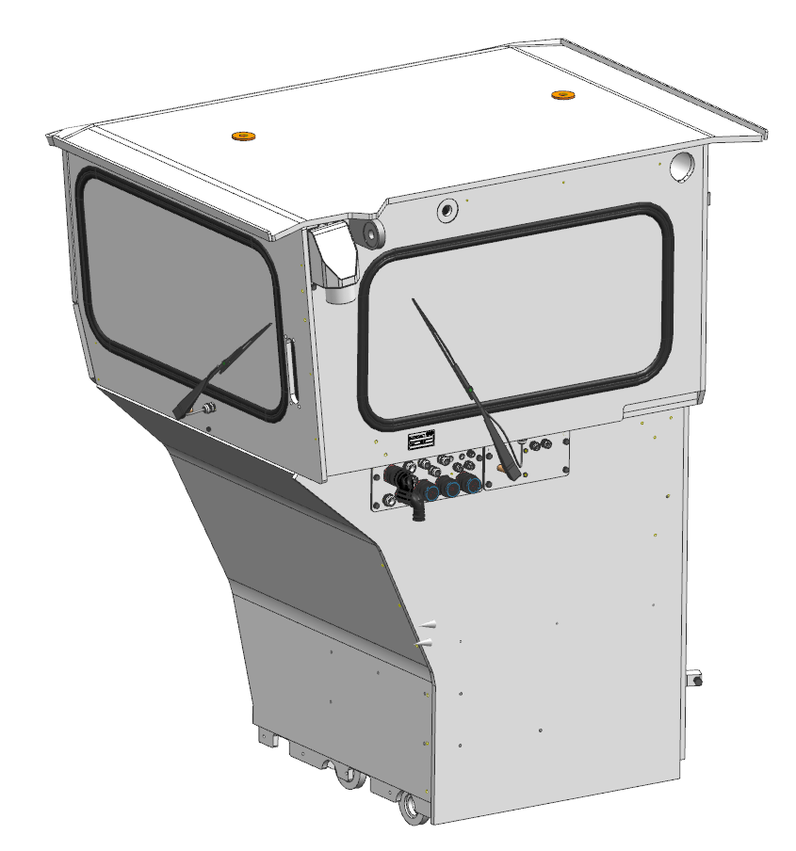
Back window
Side window
Air intake
Electrics lead-in

Slide 3
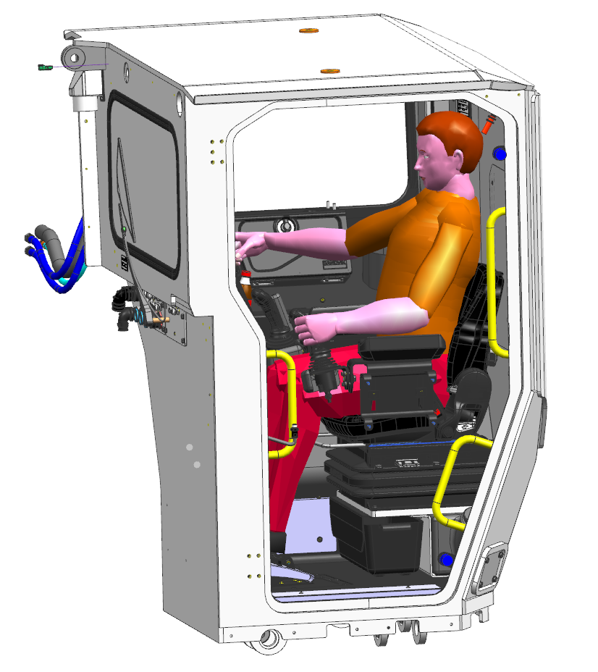
Operator driving position
Access handles

Slide 4
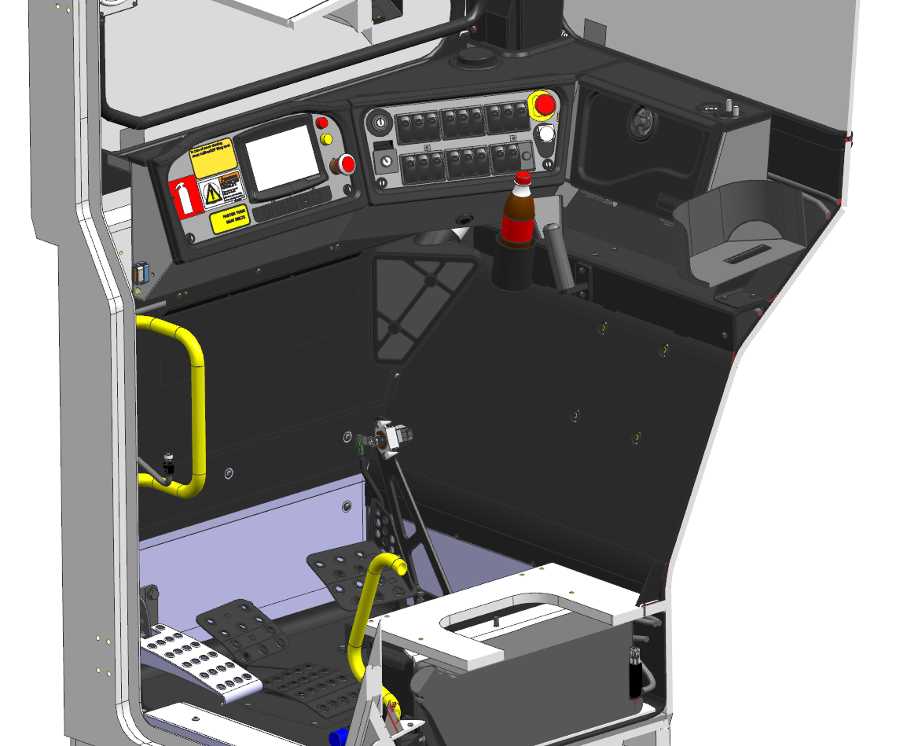
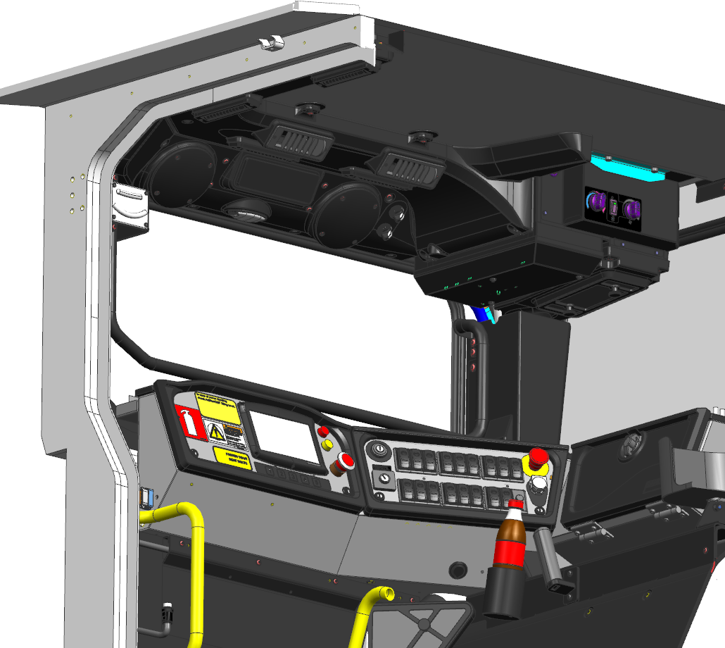
Player and speakers
Inclinometers
HVAC unit
Accessories mounting bar
Dashboard
“Horror” handle
Air filter
Foot rest
Brake pedal
Throttle pedal

Slide 5
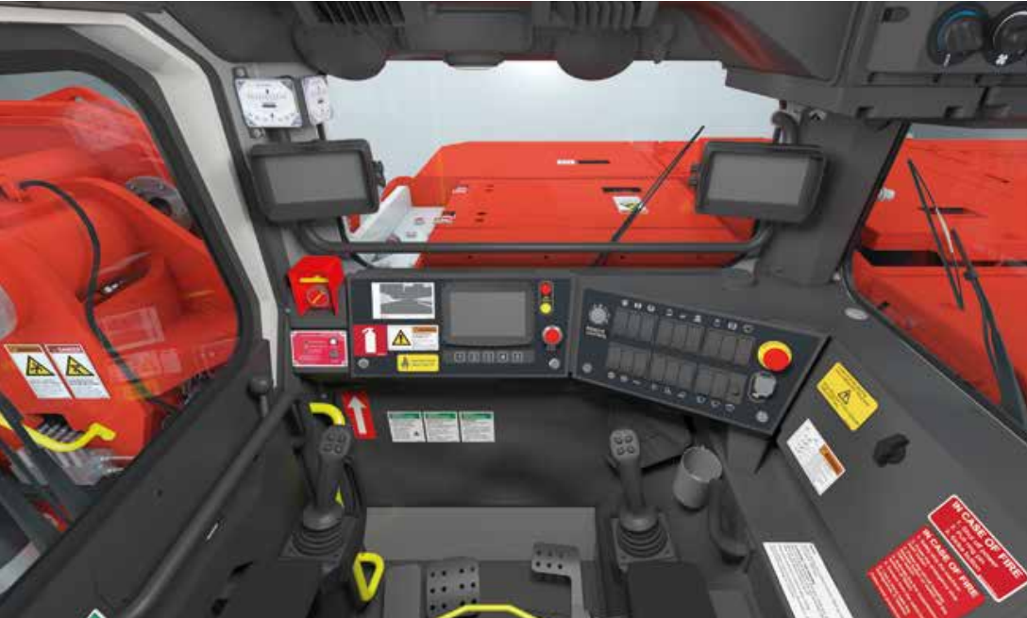
Display for forward camera
Display for reverse camera

Slide 6
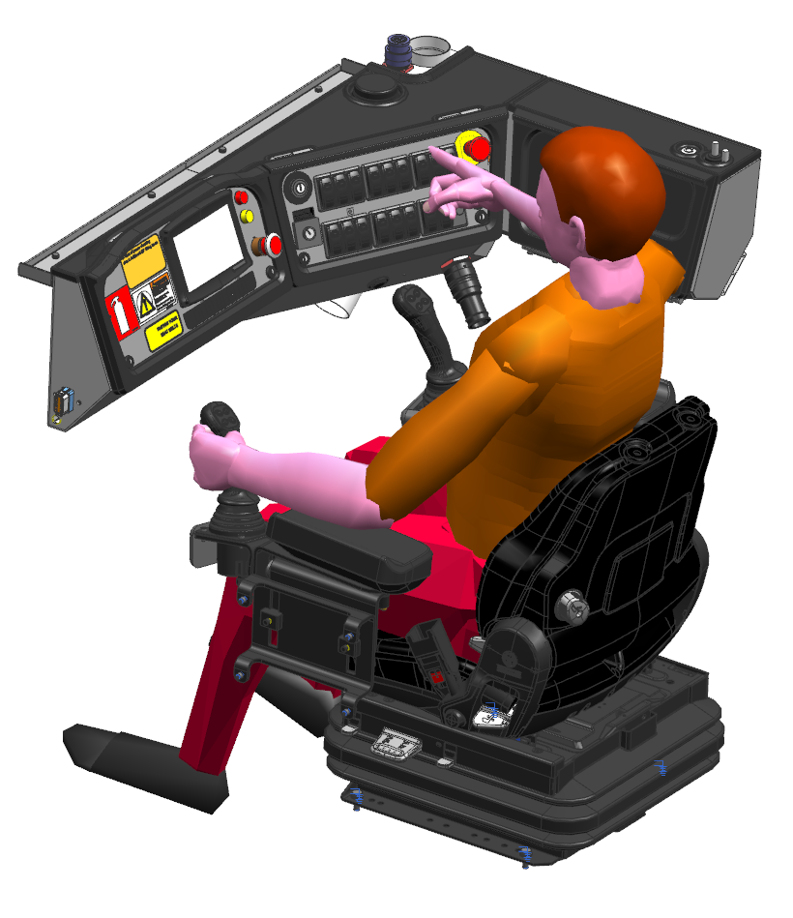
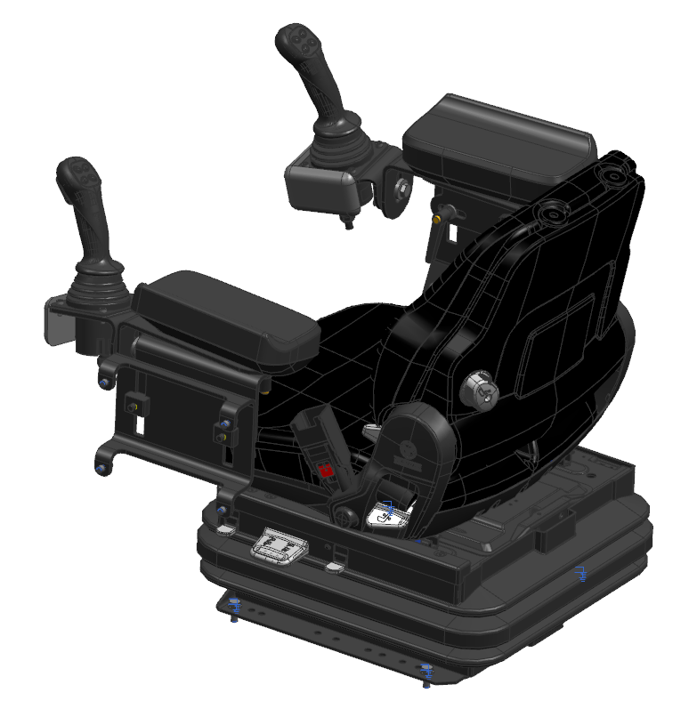
Joystick for steering
Joystick for boom and bucket movement
Armrest
Seat

Slide 7
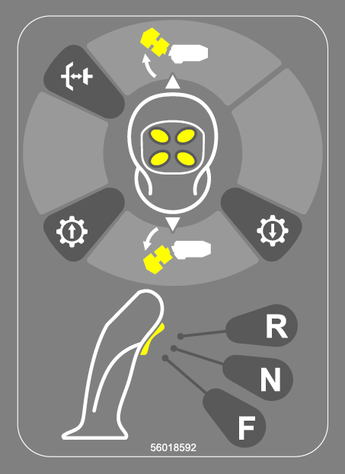
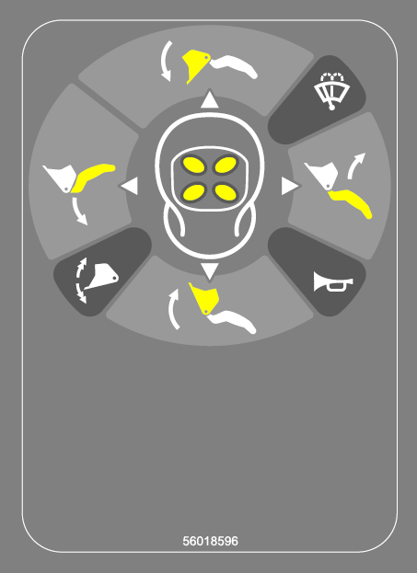

Slide 8
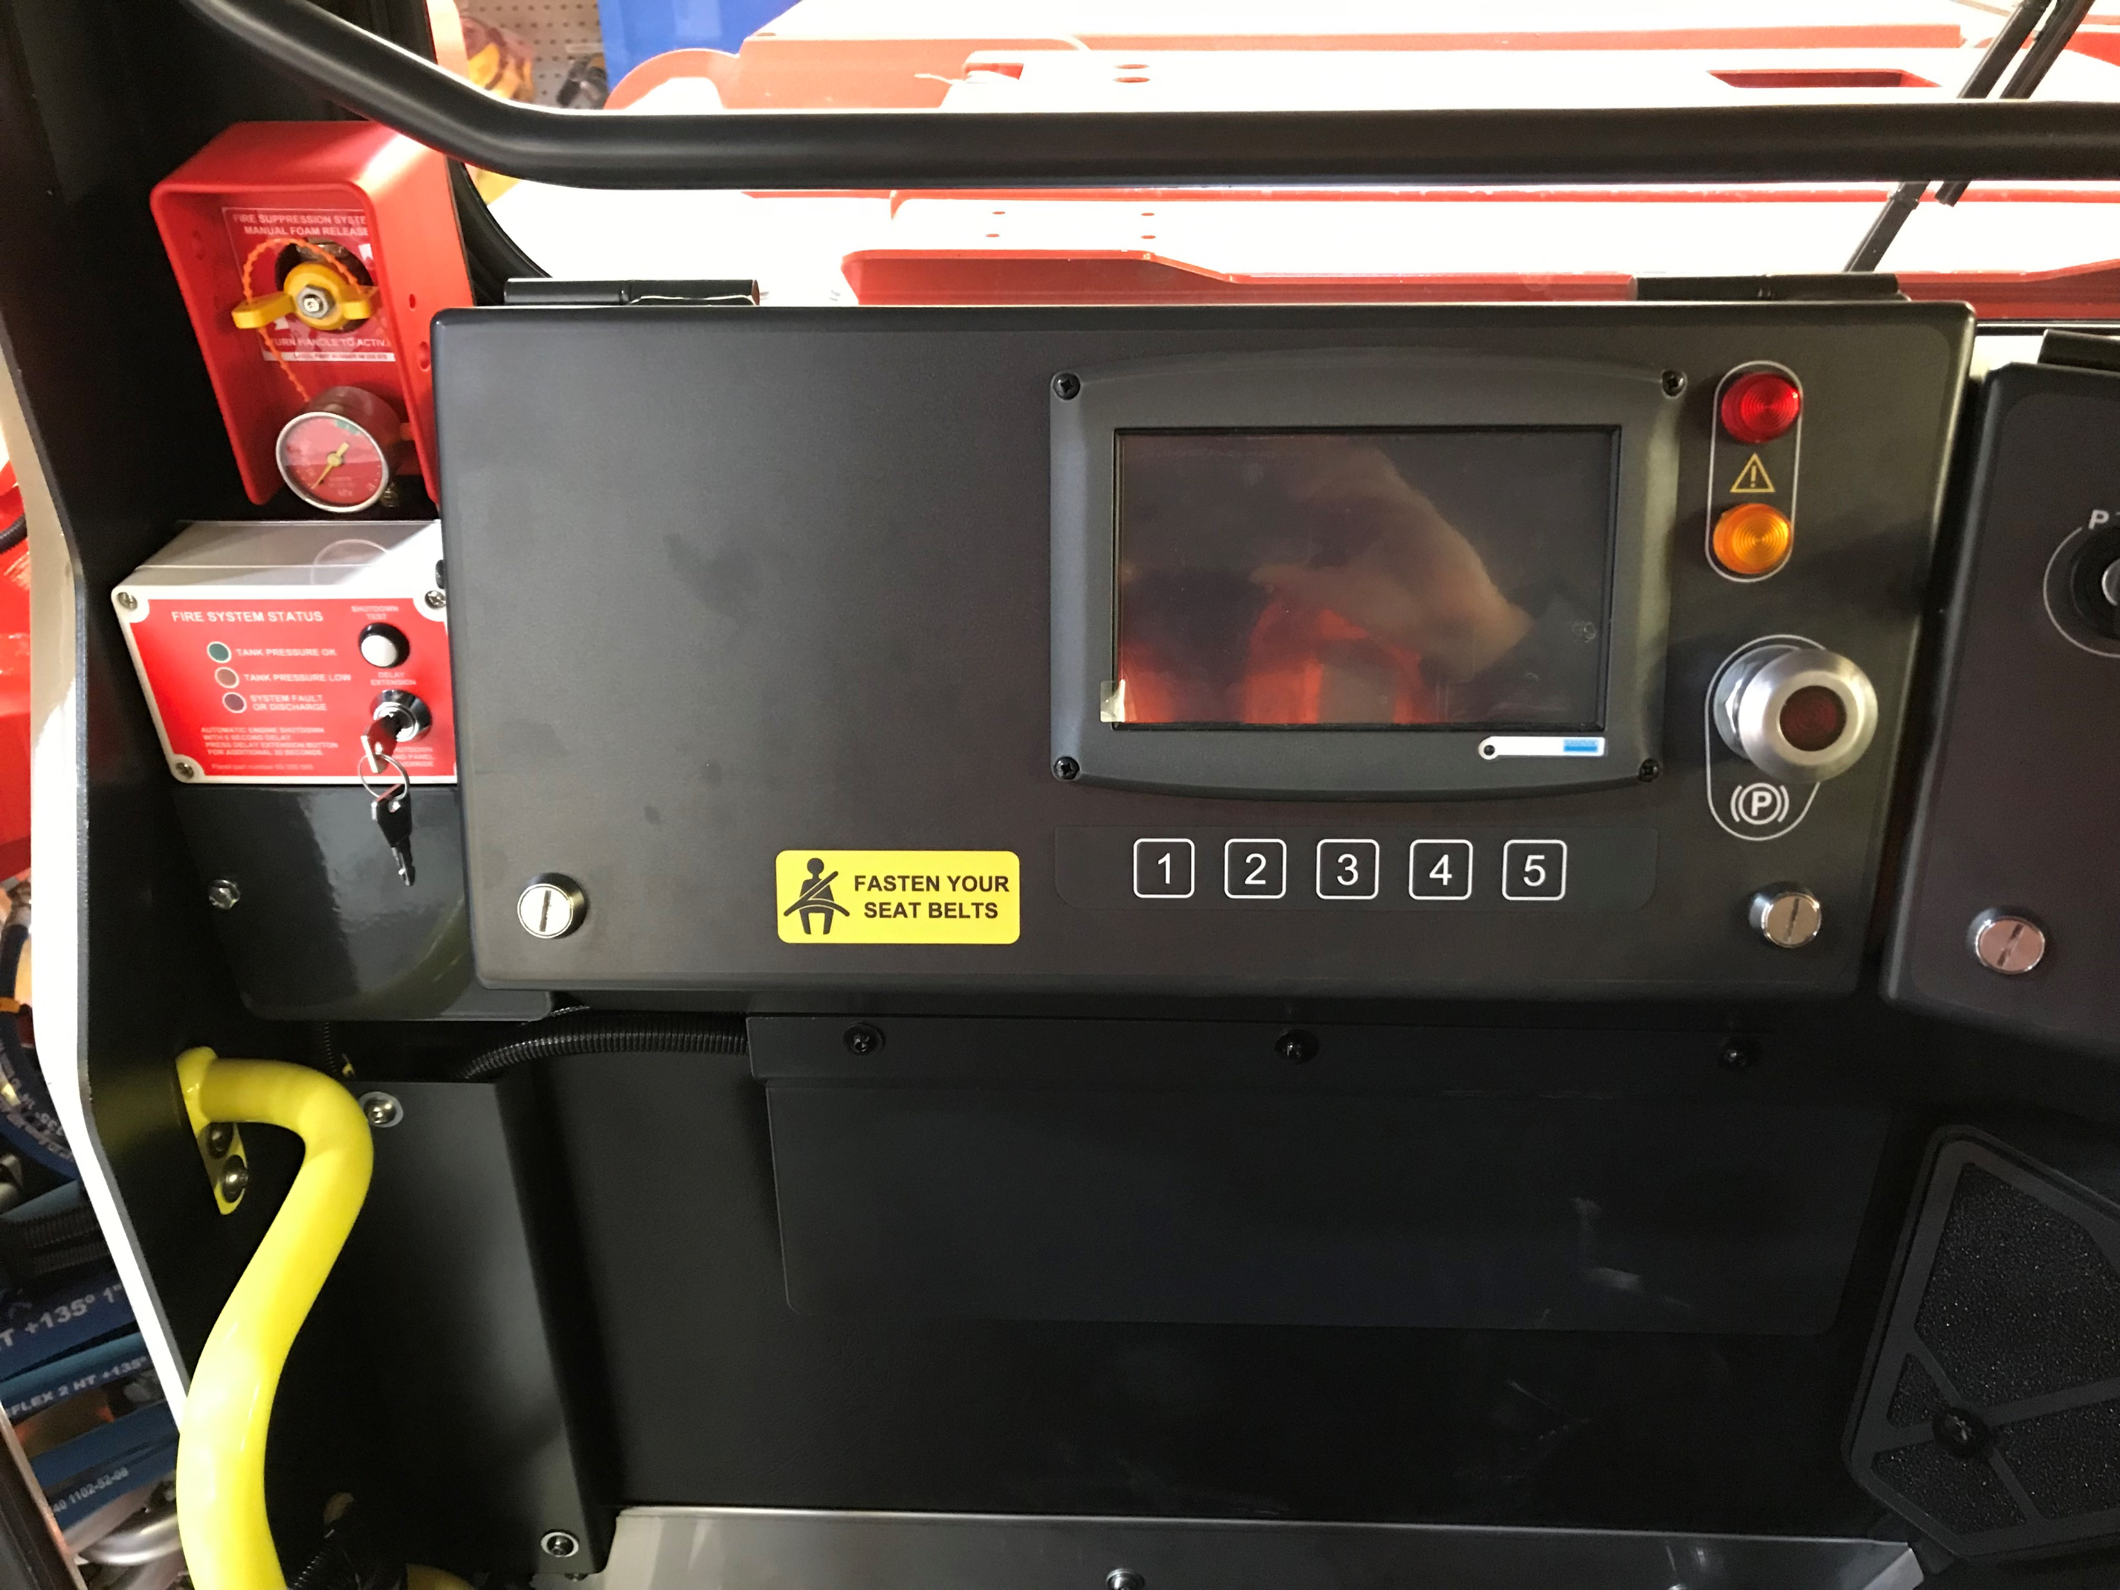
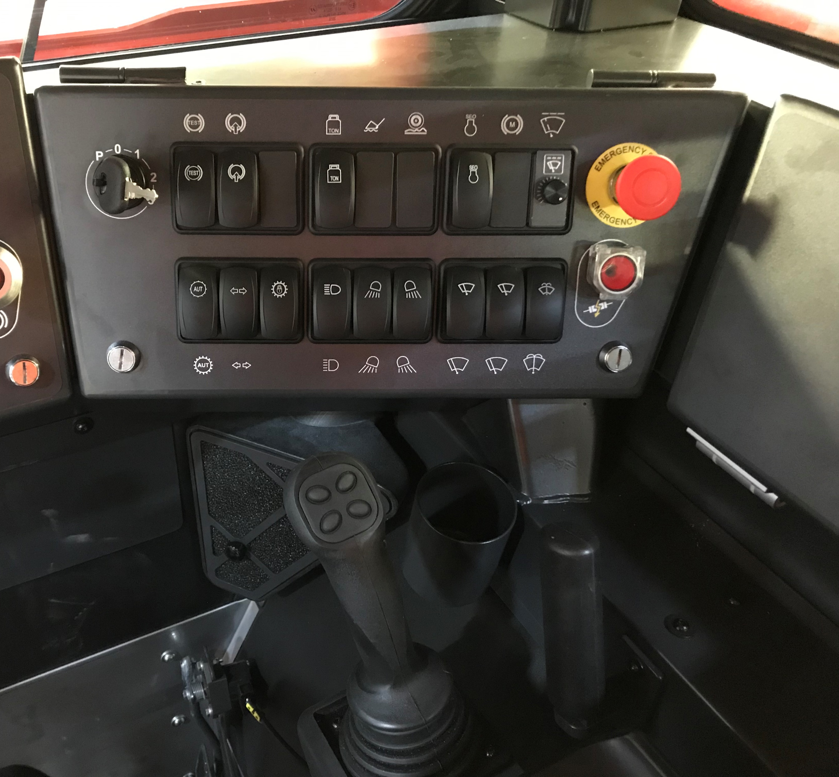
Bucket weighting
Fire extinguisher activator
Display
(touch screen)
Warning signals
Parking brake test
Brake release pump
Engine bypass
Window sweeper timer
Emergency stop
Blinkers
Buttons for display
Parking brake release
Lights on/off
Wipers front
Washer for side and back
Main fuse release
Lights low/high beam
Reverse lights
Wipers side
Auto/man. gear
Converter lock

Slide 9
Videos
https://www.youtube.com/watch?v=Hjjmy4zN_kw&t=134s
https://www.youtube.com/watch?v=Q9eGx7XDy1A&t=5s

