Slide 1
Operator environment
General Presentation

Slide 2
At the forefront of operator wellbeing
R&D process
Main focus areas
Cabin functions
Working environment
Operator demographics
Challenge for the hackers

Slide 3
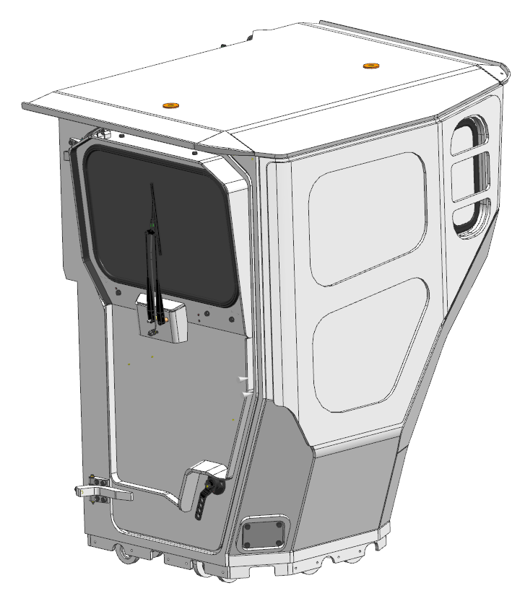
R&D process
Customers
Sandvik
Expertise
Draft
Pre-study
Analysis
Development
Design
Design finalization
Feedback
Prototyping

Slide 4
Main focus areas
Design
Human centric and HMI design
Mechanical design
Industrial design
Graphics and signs
Sandvik look and feel
Brand identity
Develop design tools and methods
In operator environment R&D
Ergonomics
Physical
  Operating position
  Access pathways
  Vibrations
  Noise
  Visibility
Cognitive
  HMI
  Information
  Errors
  Stress
Organizational
  Social systems
  Working culture
  Work planning
Safety
Safety equipment
Emergency exit
Safe components
Safe materials
Maintenance
Standards
Compliance of EHS standards
ROPS and FOPS
Components
Select
Study and develop
  Seats
  Controls
  HVAC systems
Co-op with stakeholders and partners
Studies and development projects
Suppliers and manufacturers
Officials, MTT, VTT,
Universities
Industrial design offices
Engineering offices
Technology
Utilization of latest technology
Study
Development

Slide 5
Cabin functions
In operating environment
Ergonomics
Optimal driving position
Controls in optimal zone of reach
Operator wellbeing
Ease of maintenance
Elimination of vibrations
Elimination of noise
Elimination of heat
Visibility from the cabin
Safety
ROPS certified cabin frame to protect from falling rocks and machine tipping over
Prevent objects entering cabin
Heavy duty (durable) components
No hydraulics inside cabin
No fire risk components inside cabin
Flame resistant or retardant materials
Clean and fresh air supply
Reduce risk of accidents
Maintain health and wellbeing
Maximize comfort
Maximize productivity
Protect operator in a case of accident

Slide 6
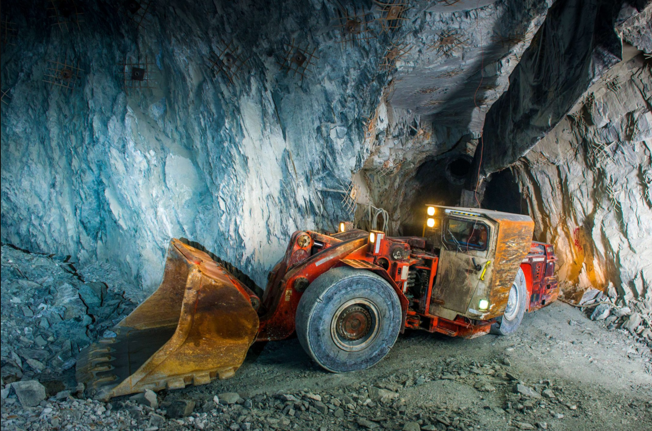
Working environment
In underground mining
Why are machines designed like that?
The most challenging working environment in the planet
Total darkness
High temperatures 60 °C and up
High moisture up to 80 – 100 % RH
Water pouring from tunnel walls like a monsoon rain
Narrow and low tunnels, bad road conditions
Falling rocks and collapsing tunnels
No air
Poisonous gasses
Explosive gasses
Harmful particles and asbestos
Corrosive salts
Signals getting blocked

Slide 7
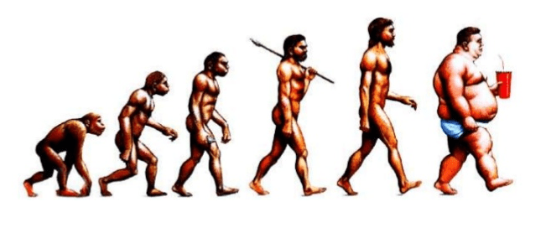
Operator demographics
In underground mining
Sandvik machines are sold globally to every continent.
Variations in operator physics and mental abilities are enormous.
Size between ANSUR 5 percentile (female) and 99 percentile (male)
153 cm / 55 kg and 191 cm / 93 kg
Educational background from illiterate to highly educated
Experience in mining from none to expert
Differences in ways employees are treated
Intentional misuse of machine
Ability and willingness to maintain machine
Access to information and tools
Cheap labour = manual work VS. expensive labour = automation
Image: typical operators

Slide 8
Challenge for the hackers
"An ergonomic environment is increasingly important in modern workplaces. In the mining industry, the machine features and performance are usually the focus, while effort on the condition for the operators spending time in the hot, dark and dangerous mines is secondary. Sandvik want to break this trend and find ways to create a better environment for the operators.”
What would be ways to increase the ergonomics of modern mining vehicles to keep operators healthy, happy and safe?
What could a new kind of operator interface (HMI) look like? What could be done to reduce the impact stress and strain (both mental or physical) on the operator?

Slide 9

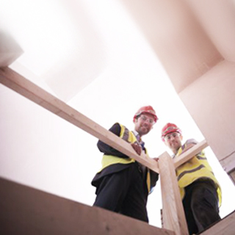
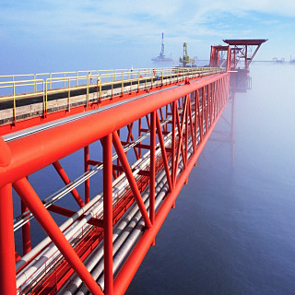
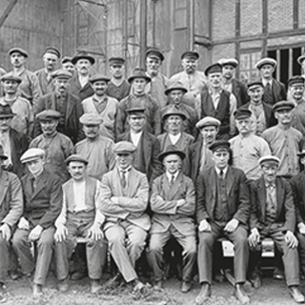

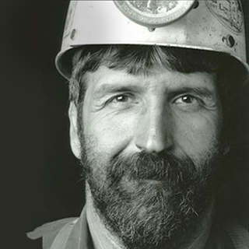
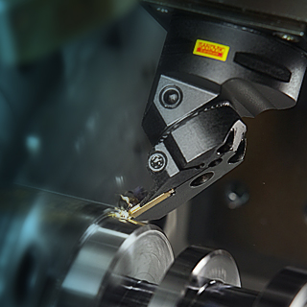
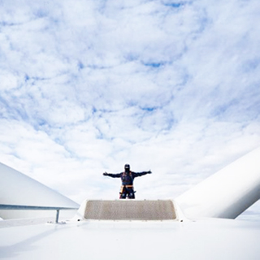
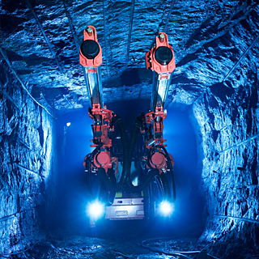
www.sandvik.com

