Slide 1
Charismatic leadership & participative leadership

Slide 2

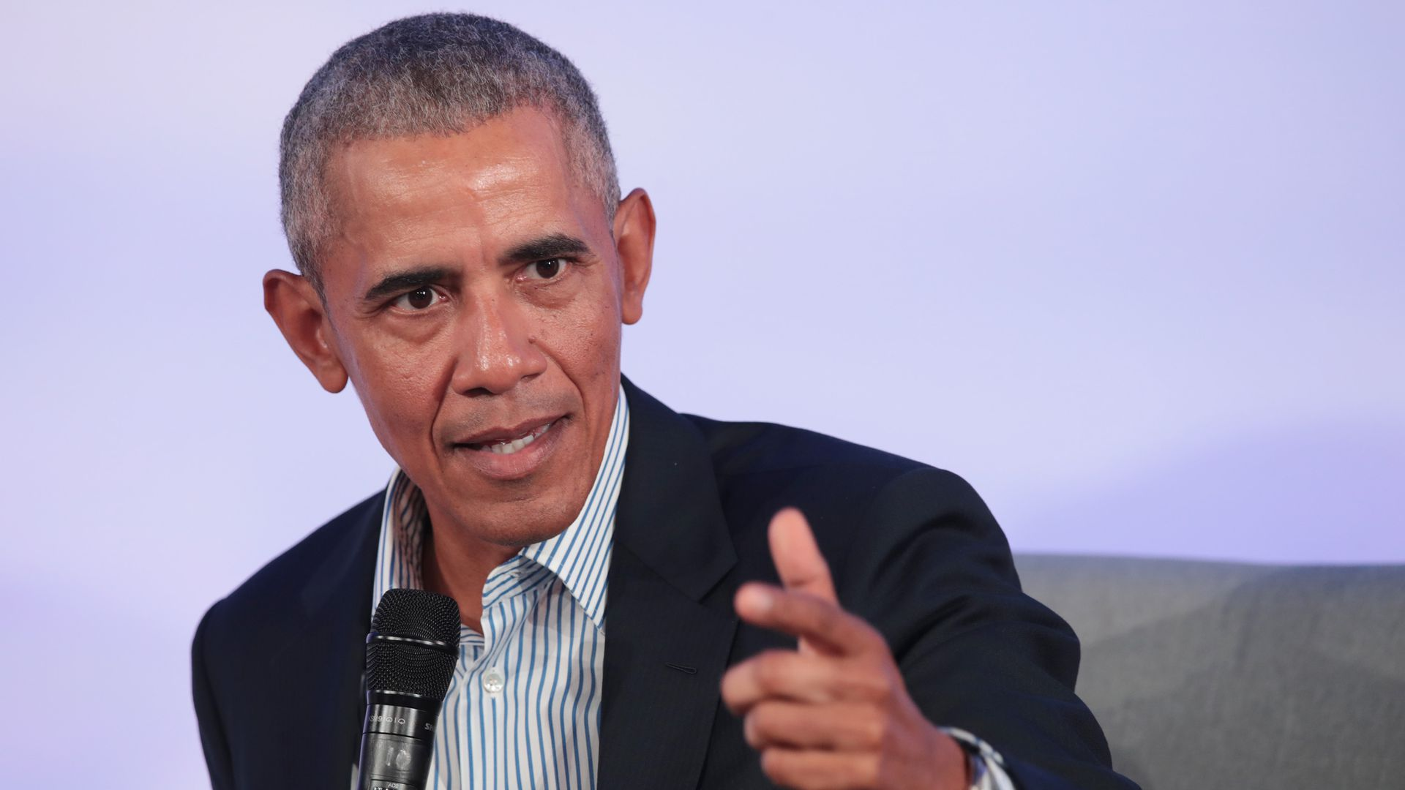
Charismatic leadership
Charismatic leaders motivate followers to get things done or improve the way certain things are done.
This leadership style is almost of divine origin.
These individuals are very eloquent verbally and they have the ability to communicate with the people they lead on a profound, emotional level.
They have the capacity to evoke strong emotions in their followers as well.
the ability of these individuals to articulate a captivating or compelling vision.
E.g. Barack Obama

Slide 3
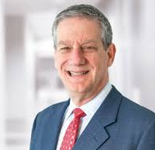
Participative Leadership
Participative leadership is a managerial style that invites input from employees on all or most company decisions.
Advantages: Acceptance of Decisions More Likely, Improves Employee Morale, Encourages Creative Solutions, Increases Employee Retention, Decreases Competition, Increases Collaboration etc.
E.g. Jack Stahl (former CEO of Coca-Cola)

